Slide 1
Lecture 2: Why Markets Fail
Prof. Parthum
Environmental Economics Econ 475

Slide 2
Resources for Learning R
(and other useful tools for data science)
Note: These are extracurricular and not required for this course! You asked ☺
Introduction to R for Economists
Great video series (with links and replication code!) for just getting started (i.e., if you’ve never even installed R before)
He has many other advanced videos (masters, Phd, etc.) that are well done. With replication code and data!
Data Science for Economists
PhD-level data science course, but very accessible for any level
Lecture 4 specifically covers R. But the whole course covers the necessary pieces for building a reliable and efficient data science ecosystem
Having some experience programming experience is useful, but not required

Slide 3
We all have that friend
“Anyone who has taken Econ 101 knows…”
If someone starts a sentence with this, anything that follows is likely to be an incomplete picture of whatever the topic is.

Slide 4
We all have that friend
“Anyone who has taken Econ 101 knows…”
If someone starts a sentence with this, anything that follows is likely to be an incomplete picture of whatever the topic is.
Markets are great! But they are not perfect.

Slide 5
We all have that friend
“Anyone who has taken Econ 101 knows…”
If someone starts a sentence with this, anything that follows is likely to be an incomplete picture of whatever the topic is.
Markets are great! But they are not perfect.
Markets provide powerful incentives for innovation, production, price discovery, a general move towards economic efficiency, and many more desirable outcomes that improve the wellbeing of societies (note, “wellbeing” is a general term that is used to describe more than just income!)

Slide 6
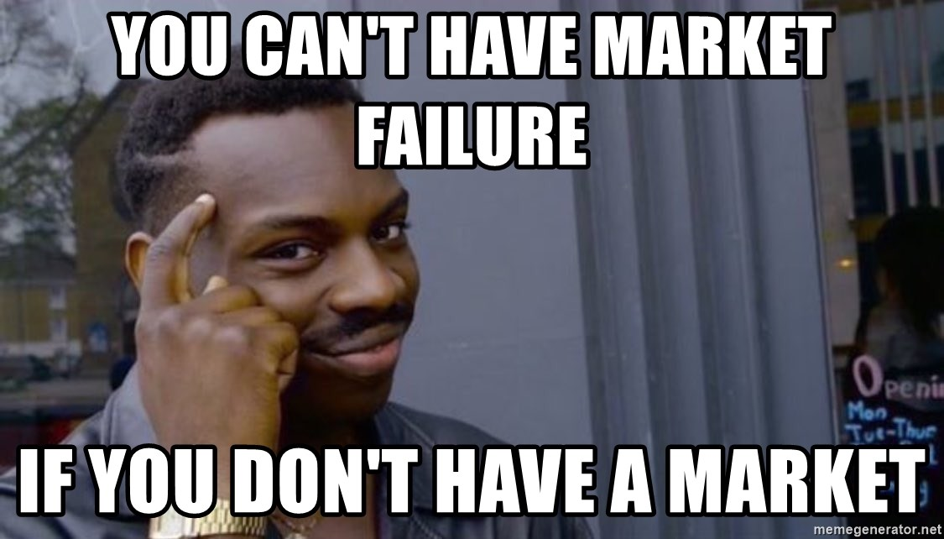
So, “free markets” are bad?

Slide 7
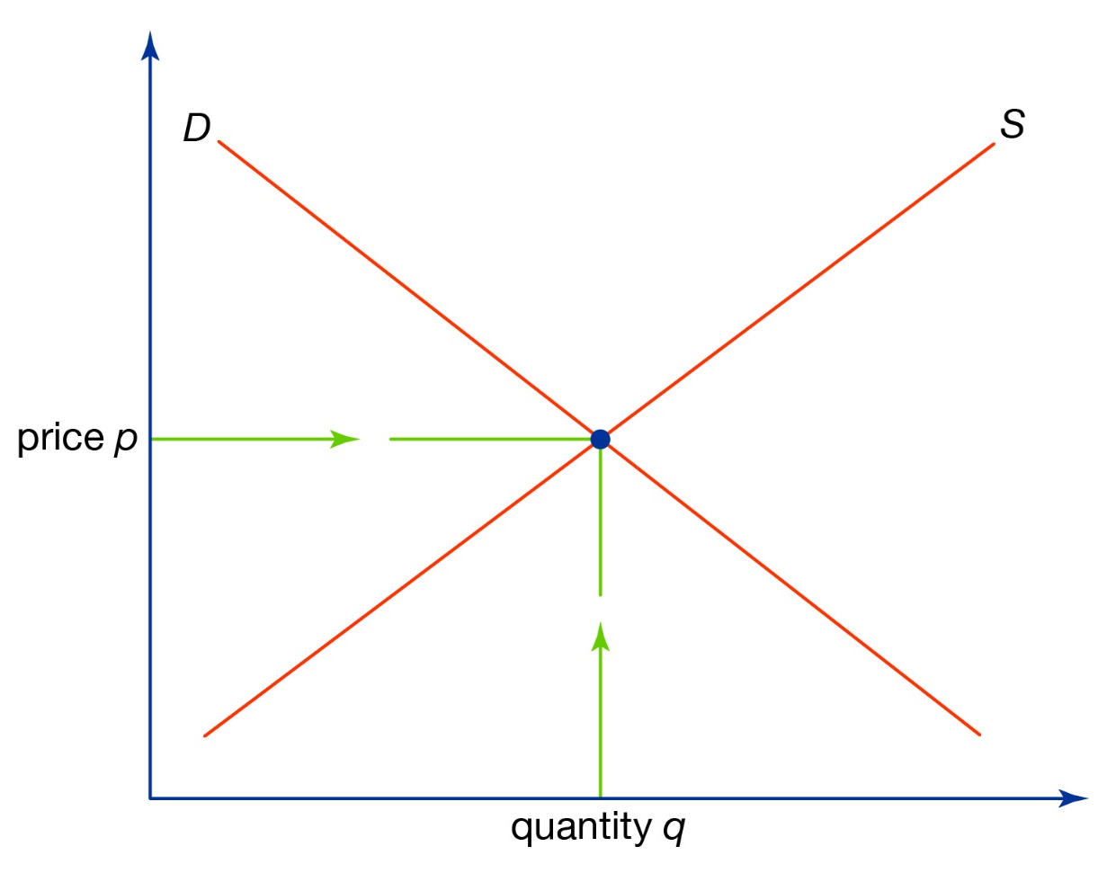
An Example: The Market for Plastic Bags
Value
Private
Marginal
Benefit
# of Bags

Slide 8
An Example: The Market for Plastic Bags
Value
Private
Marginal
Costs
Private
Marginal
Benefit
# of Bags

Slide 9

An Example: The Market for Plastic Bags
Value
Private
Marginal
Costs
Private
Marginal
Benefit
$$b^{∗}$$
# of Bags

Slide 10
An Example: The Market for Plastic Bags
What’s missing?
Value
Private
Marginal
Costs
Private
Marginal
Benefit
$$b^{∗}$$
# of Bags

Slide 11
An Example: The Market for Plastic Bags
What’s missing?
The external marginal cost
Value
Private
Marginal
Costs
Private
Marginal
Benefit
$$b^{∗}$$
# of Bags

Slide 12
An Example: The Market for Plastic Bags
What’s missing?
The external marginal cost
Value
Private
Marginal
Costs
Private
Marginal
Benefit
External
Marginal
Costs
$$b^{∗}$$
# of Bags

Slide 13

An Example: The Market for Plastic Bags
What’s missing?
The external marginal cost
Adding the external cost to the private recovers the (true) social marginal cost
Value
Social
Marginal
Costs
Private
Marginal
Costs
Private
Marginal
Benefit
External
Marginal
Costs
$$b^{∗}$$
# of Bags

Slide 14


An Example: The Market for Plastic Bags
What’s missing?
The external marginal cost
Adding the external cost to the private recovers the (true) social marginal cost
The socially optimal number of bags is fewer than the private
Value
Social
Marginal
Costs
Private
Marginal
Costs
Private
Marginal
Benefit
External
Marginal
Costs
$$Q_{s}^{∗}$$
$$Q_{p}^{∗}$$
# of Games

Slide 15


An Example: The Market for Plastic Bags
What’s missing?
The external marginal cost
Adding the external cost to the private recovers the (true) social marginal cost
The socially optimal number of bags is fewer than the private
What is a possible fix?
Value
Social
Marginal
Costs
Private
Marginal
Costs
Private
Marginal
Benefit
External
Marginal
Costs
$$b_{s}^{∗}$$
$$b_{p}^{∗}$$
# of Bags

Slide 16

An Example: The Market for Plastic Bags
What’s missing?
The external marginal cost
Adding the external cost to the private recovers the (true) social marginal cost
The socially optimal number of bags is fewer than the private. The private market overprovides bags
What is a possible fix?
A tax equal to the external marginal cost
Value
Social
Marginal
Costs
Private
Marginal
Costs
Private
Marginal
Benefit
External
Marginal
Costs
$$tax$$
$$Q_{s}^{∗}$$
$$Q_{p}^{∗}$$
# of Games

Slide 17



An Example: The Market for College Education
In education, the externality is a “good”
The private market would underprovide public education
A government subsidy can help correct this market failure
In this context, is the external marginal benefit actually fixed (flat)?
Try drawing an example of what you think external marginal benefits are
Value
Private
Marginal
Costs
Social
Marginal
Benefit
Private
Marginal
Benefit
External
Marginal
Benefit
$$subsidy$$
$$e_{s}^{∗}$$
$$e_{p}^{∗}$$
# of years in school

Slide 18
An Example: Static Externalities
Person B
不招供
招供
不招供
A: 5 years in jail
B: 5 years in jail
A: 10 years in jail
B: 2 years in jail
Person A
A: 2 years in jail
B: 10 years in jail
A: 8 years in jail
B: 8 years in jail
招供

Slide 19
An Example: Dynamic Externalities
Pick a number between 0 and 100.
The person who is closest to 75% of the average number wins an extra point on the exam.

Slide 20
Market Failures
There are many different types or root causes of market failures. Think of some examples under each of these categories.
Information Asymmetries
One party in a transaction knows more than the other
Market Structure/Power
One party can influence the market equilibrium
Public Goods
Nonrival and nonexcludable
Externalities
Private actions have unintended effects

